Slide 1
Proliferation Financing (PF)
Presented by: Justine Plenkiewicz
Deputy National Coordinator
Kerri-Ann Gillies
Crown Counsel

Slide 2
Introduction to Proliferation Financing Counter Measures

Slide 3
Roadmap
Background on the Financial Action Task Force (FATF) and the FATF Standards
The results of the Mutual Evaluation Report (MER) of the Cayman Islands in relation to PF (Key Findings & Recommended Actions)
PF counter measures and Targeted Financial Sanctions (TFS)
Risk Factors in relation to PF
Typologies

Slide 4
Financial Action Task Force (FATF)
Intergovernmental ‘taskforce’ established in 1989
Initially established to develop measures to combat money laundering (ML)
2001 – mandate expanded to incorporate efforts to combat terrorist financing (TF)
2012 – added efforts to counter the financing of proliferation of weapons of mass destruction (PF)

Slide 5
How does the FATF operate?
FATF sets international standards for combating ML, TF, PF and other related threats to the integrity of the international financial system.
The FATF monitors the progress of its members; FATF's decision making body, the FATF Plenary meets three times per year
FATF’s global reach is complemented by FATF-style regional bodies eg. CFATF

Slide 6
The FATF Recommendations
Recognised as the international standard for combating of money laundering, the financing of terrorism and proliferation of weapons of mass destruction.
First issued in 1990, subsequently revised in 1996, 2001, 2003 and most recently in 2012 to ensure that they remain up to date and relevant.
Countries are encouraged to implement the standards into their own domestic laws.

Slide 7
Methodology
Technical Compliance
- Do we have the legal requirements/ framework in place to combat ML, TF and PF?
Effectiveness
- How well does the AML/CFT/CPF framework operate?
- The FATF assesses effectiveness primarily on the basis of eleven Immediate Outcomes.

Slide 8
The Caribbean Financial Action Task Force (CFATF)
FATF-style regional body (FSRB) in the Caribbean established in May 1990
Has associate member status within the FATF
CFATF members endorse and implement the FATF Forty Recommendations
Membership of CFATF includes the Cayman Islands
CFATF Plenary usually meets two times per year

Slide 9
Cayman Islands Mutual Evaluation Report (MER)
Published in March 2019
Produced from a mutual “peer review” mechanism aimed at ensuring CFATF members comply with the FATF Standards.
Analyses the level of compliance with the FATF 40 Recommendations and the level of effectiveness of the AML / CFT system
Provides recommendations on how the regime could be strengthened.

Slide 10
Findings of MER in relation to PF
Lawyers were found generally to have a fundamental understanding of their ML/TF risks and obligations under the Anti-Money Laundering Regulations (AMLRs).
There is very little monitoring, training, guidance or awareness among most Financial Institutions (FIs) and Designated Non-Financial Businesses and Professionals (DNFBPs) (which include lawyers) on PF obligations.
There were no supervisors appointed for lawyers to ensure the implementation of their obligations.
It was recommended that authorities improve awareness within the jurisdiction of TFS obligations and ensure the designated supervisory authority monitors FIs and DNFBPs implementation and compliance of TF/PF TFS .

Slide 11
Immediate Outcome 11
Key Findings:
The absence of an effective communication mechanism, impedes the ability of FIs and DNFBPs to implement freezing actions required in implementing TFS, without delay.
The frequency of screening persons designated under UNSCRs is irregular.
The understanding of what steps should be taken in the event targeted assets are identified is limited.
Enhanced monitoring of the implementation of TFS is required.

Slide 12
There is focus on identifying assets subject to sanction at time transaction is being attempted.
While this may prevent capital flight, it will not allow for early identification of assets that should be frozen.
The understanding of the process to be applied, if assets subject to sanctions were identified, varied.

Slide 13
Recommended Actions
Implementation of timely communication mechanisms for TFS relating to PF to facilitate the freezing of assets without delay by FIs and DNFBPs.
Provision of outreach and guidance to FIs and DNFBPs on how to identify PF as well as reinforce the process where assets are identified.
Increase staff training within FIs and DNFBPs to ensure proper and efficient identification of persons and assets subject to TFS, as well as the processes to be followed where such persons and assets are identified.
Review of co-operation and co-ordination mechanisms to ensure that the authorities can identify potential breaches or violations of TFS related to PF.

Slide 14
Response to MER
Establishment of the post of National Coordinator and formation of National Coordination team
Formation of the PF working group, the Proliferation Inter Agency Group (PIAG) which is a sub-committee of the Inter-Agency Coordination Committee (IACC)
Cayman Islands Legal Practitioners Association (CILPA)
Establishment of the Cayman Islands Regulation Authority (CARA) – the AML/CFT supervisory body for Attorneys in the Cayman Islands

Slide 15
What is Proliferation Financing (PF)?
There is no single internationally agreed definition.
FATF has a working definition –
‘Proliferation Financing’ refers to: the act of providing funds or financial services which are used in whole or in part, for the manufacture, acquisition, possession, development, export, transshipment, brokering, transport, transfer, stockpiling or use of nuclear, chemical or biological weapons and their means of delivery and related materials (including both technological and dual-use goods for non-legitimate purposes) in contravention of national laws, or, where applicable, international obligations.
N.b. Financial Services can include financial transfers, mortgages, credit lines, insurance services, middlemen services, trust and corporate services and company formation

Slide 16
The FATF Standards address PF in:
-Recommendation 2: National Cooperation and Coordination on Financial Crime Risks including ML, TF and PF
-Recommendation 7: Targeted Financial Sanctions (TFS) against specific proliferating actors designated by United Nations Security Council Resolutions (UNSCRs)
-Immediate Outcome 1: Coordination of actions domestically to combat ML, TF and PF
-Immediate Outcome 11: Requires jurisdictions to develop and implement policies and activities to combat the financing of proliferation of Weapons of Mass Destruction (WMD) in addition to implementing TFS without delay.

Slide 17
The UN Security Council’s Approach Re PF
Two-tiered approach:
(i) Global Approach under UNSCR 1540 (2004) (and successor provisions)
-Broad based provisions prohibiting financing of proliferation-related activities by non-state actors
-Requires countries to establish, develop, review and maintain appropriate controls on providing funds, services such as financing, related to the export and transshipment of items that would constitute WMD
-Relevant to Recommendation 2 and other FATF requirements on AML and CTF

Slide 18
(ii) Country-specific Approach under UNSCR 1718 (2006) and UNSCR 2231 (2015) (and their successor resolutions)
-Resolutions against the Democratic People’s Republic of Korea (DRPK) (North Korea) and Iran
-DPRK sanctions regime has expanded
- Prior Iran sanctions (under UNSCR 1737) terminated – (Joint Comprehensive Plan of Action)
-TFS in UNSCR 1718 and 2231 are required to be implemented under Recommendation 7

Slide 19
Mechanisms for targeting Proliferation
Export Controls
-restraints on trade in specified ‘dual use’ goods and technologies capable of having a military use and on other items where there is a concern about end use (e.g. for military or nuclear proliferation purposes).
Financial Measures
-prohibitions and restrictions on trade, financial transactions and travel as well as broad-ranging asset freezes.

Slide 20
Sanctions
Prohibitions and restrictions placed on specific individuals, countries, entities, organisations, vessels, goods and services
Usually involve trade embargos and financial measures
The role of sanctions is to help maintain or restore global peace and security
The most common financial sanctions are asset freezes and restrictions on access to financial services and markets

Slide 21
FATF Glossary Definitions
Targeted Financial Sanctions:
“The term targeted financial sanctions means both asset freezing and prohibitions to prevent funds or other assets from being made available, directly or indirectly, for the benefit of designated persons and entities.”
Designation:
“The term designation refers to the identification of a person (natural or legal) that is subject to targeted financial sanctions pursuant to…
Security Council resolution1718 (2006) and any future successor resolutions;
Security Council resolution 2231 (2015) and any future successor resolutions…
(N.b. The definition includes other UNSCR designations)

Slide 22
Role of TFS in CPF
Preventative Value
- Impedes production of WMD by cutting off access to key resources/finances
Investigative Value
- Authorities obtain documents to assist in investigations
Analytical Value
Authorities are able to uncover broader proliferation networks (Identify Proliferators, Facilitators, Financiers, Shipping & Insurance providers, front companies etc.
Deterrent Value
- Especially re individuals considering but unsure about engaging in activity

Slide 23
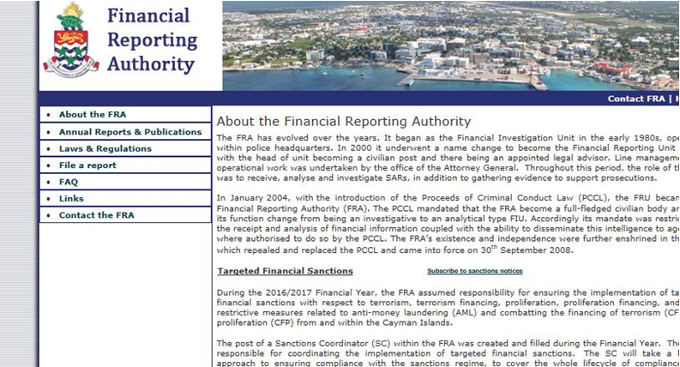
TFS notifications: http://fra.gov.ky/contents/page/1

Slide 24
TFS in the Cayman Islands
The Governor of the Cayman Islands is the competent authority for the implementation of TFS
Function of receiving certain reports delegated to the Financial Reporting Authority (FRA) the Cayman Islands’ Financial Intelligence Unit (FIU)
Sanctions Coordinator is responsible for coordinating the implementation of TFS with respect to terrorism, TF, proliferation and PF.

Slide 25
CPF Domestic Law Framework
Proliferation Financing (Prohibition) Law (2017 Revision [PFL]
Proceeds of Crime Law (2019 Revision) [PCL]
Anti-Money Laundering Regulations [AMLRs]
Iran (Sanctions) (Overseas Territories) Order 2016
Democratic People’s Republic of Korea (Sanctions) (Overseas Territories) Order 2012

Slide 26
The Proliferation Financing (Prohibition) Law (PFL)
Cayman Islands – The Proliferation Financing (Prohibition) Law provides the legal basis for domestic implementation of TFS-PF in relation to UNSCRs imposed on the designated countries and persons.
Section 2(1) – the interpretation and definition section defines designated person:
“designated person” means a person, including any subsidiary or other entity owned or controlled by that person, to whom Security Council anti-proliferation financing measures relate

Slide 27
Section 2A addresses the Financial Reporting Authority (FRA) disseminating as soon as practical, lists of designated persons published by the Security Council
Section 2B speaks to the obligation on all persons to immediately freeze funds or economic resources in their possession that are:
-owned or controlled by a designated person; or
-derived or generated from funds or economic resources owned or controlled by a designated person
Under section 2C, a person who has taken action under section 2B(1) shall ensure that they are not made available to or for the benefit of a designated person, and also to disclose these details to the FRA.

Slide 28
Section 23A of the PFL states:
“A person who –
provides funds and economic resources to fund unauthorised proliferation activities; or
(b) enters into or becomes concerned in an arrangement which that person knows or suspects facilitates, by whatever means, the acquisition, retention, use or control of funds and economic resources to fund unauthorised proliferation activities,
commits a money laundering offence for the purposes of the Proceed of Crime Law (2017 Revision) and the provisions of that Law shall apply in the investigation and prosecution of the offence and to any other procedure relating to that offence.”

Slide 29
Iran (Sanctions) (Overseas Territories) Order 2016
Gives effect in in the Cayman Islands to sanctions in respect of Iran set out in UNSCR 2231
Creates offences in relation to:
-dealing with funds of designated person or make economic resources available to, or for the benefit of, a designated person
-knowingly selling, supplying, transferring or exporting (directly or indirectly) restricted goods to any Iranian person or for use in Iran or participate in such transfer.
-providing a relevant service to a ship or cargo aircraft owned or controlled by an Iranian person where there is reasonable cause to believe that the ship or aircraft is carrying prohibited goods.

Slide 30
Democratic People’s Republic of Korea (Sanctions) (Overseas Territories) Order 2012
Gives effect in in the Cayman Islands to sanctions in respect of Iran set out in UNSCR 1718
Creates offences in relation to:
-dealing with funds of a designated person or make economic resources available to, or for the benefit of, a designated person
- knowingly selling, supplying, transferring or exporting (directly or indirectly) restricted and luxury goods to any person in DPRK or for use in DPRK and to purchase such goods from DPRK;
- providing a relevant service to a ship or cargo aircraft owned or controlled by an DPRK person where there is reasonable cause to believe that the ship or aircraft is carrying luxury or restricted goods;
- procuring vessel or aircraft crew from DPRK
- providing financing or assistance for trade with DPRK (incl. granting guarantees) or to a DPRK company
- providing a bank account to a DPRK diplomatic mission
- leasing or make available real property for DPRK Government
- providing certain computer services

Slide 31
Anti-Money Laundering Regulations
Relevant Financial Businesses must have:
Procedures for ongoing monitoring of business relationships or one-off transactions for the purposes of preventing, countering and reporting (…) proliferation financing and such procedures allowing for the identification of assets subject to TFS applicable in the Islands
Internal controls to prevent PF
Procedures to ensure compliance with TFS obligations applicable in the Islands
Staff training on PF and TFS

Slide 32
PF Profile
RAISE OBSCURE PROCURE (and ship)
In PF, transactions often look like normal commercial activity, structured to hide the source of funds

Slide 33
Characteristics of Proliferation Networks
Exploit countries with weak export and financial controls
The same channels are often used
Transactions normally take place through formal financial channels
Mask procurement as legitimate trade and purchase proliferation-sensitive goods in the open market
Use of complex networks of procurement, agents, intermediaries, front companies, trade brokers (in multiple jurisdictions) to disguise the true end-use/ end-user

Slide 34
PF Risk Factors
FATF does not require jurisdictions to formally assess risk related to PF, but a risk assessment is a recognised precursor for an effective response to PF.
Types of Risk:
- Country/ Geographical
- Customer
- Product/Service Risk

Slide 35
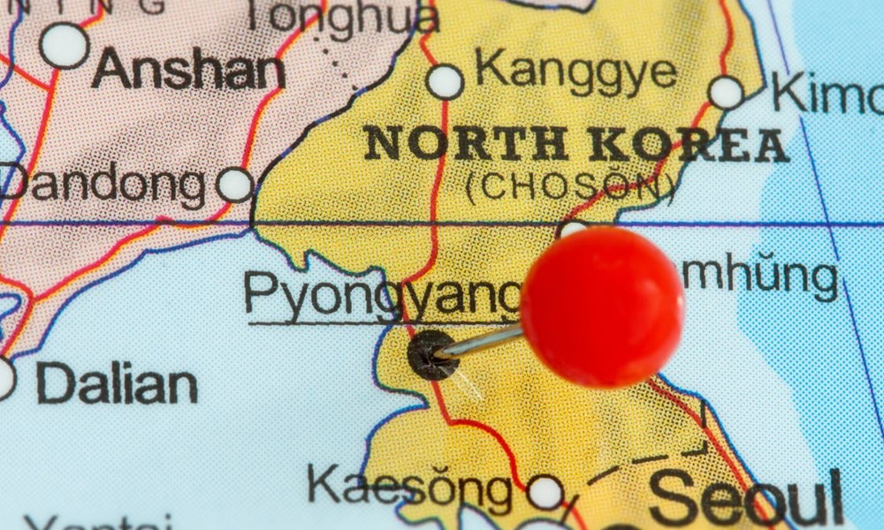
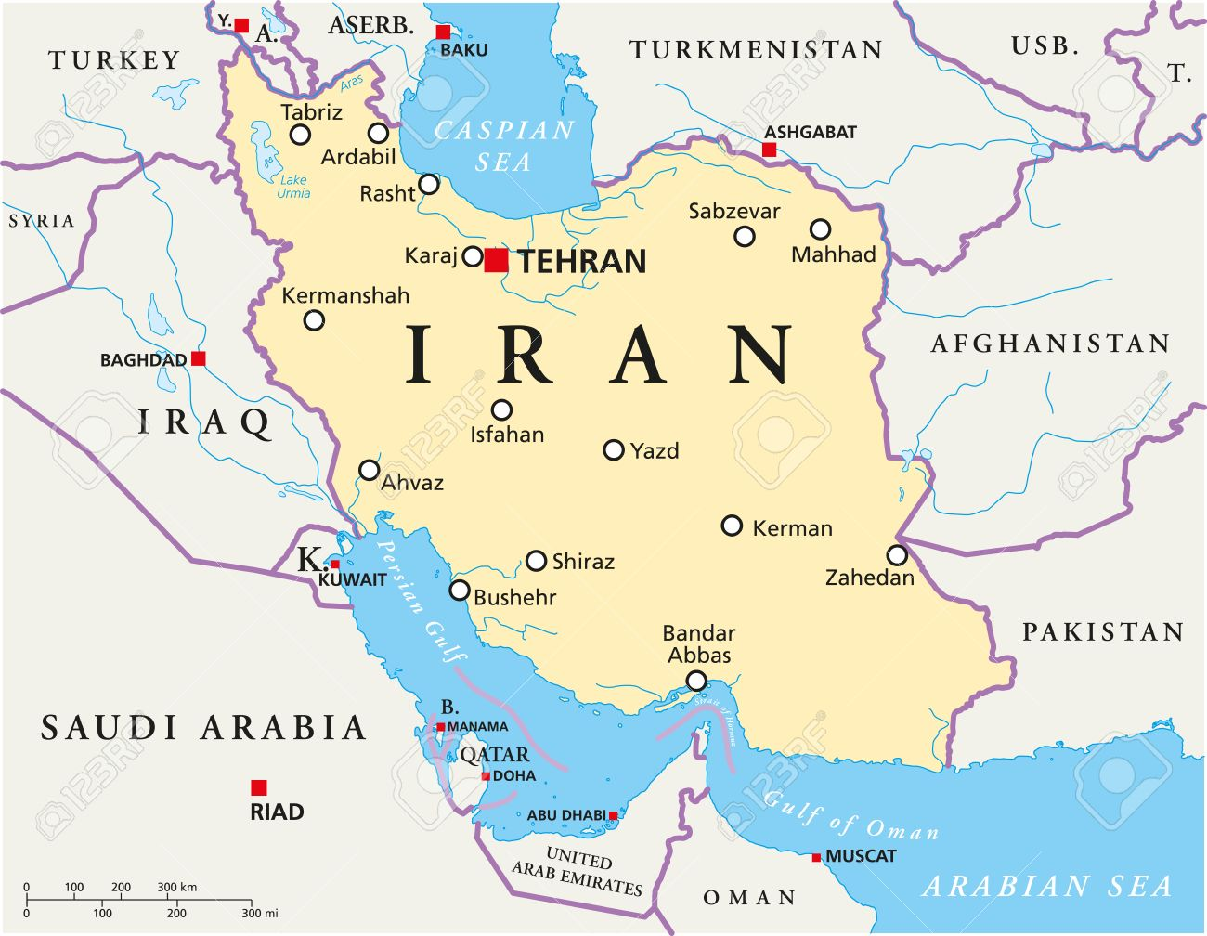
Country/Geographical Risks

Slide 36
Cayman Islands as an International Financial Centre
Risks associated with countries subject to sanctions against proliferation e.g. DPRK and Iran
Countries of Diversion concern re PF
-for DPRK e.g. specific ports in East China – Dandong; Dalian);
- for Iran eg. United Arab Emrates (UAE);Turkey
Embargoed destination of countries that have strong links to terrorist groups/ activities
Links with Countries with historical, political and trade relationships with countries of proliferation concern
Countries in which facilitation networks are known to operate/ exploit (n.b. UN Panel of Experts Reports and other Literature)
Countries with weak export/financial controls (lack of robust AML/CFT systems/ weak implementation of TFS)

Slide 37
Customer Risk
Customers seeking anonymity
Consider where customer is involved in the supply, purchase or sale of dual-use, proliferation sensitive or military goods.
High-Risk customers – Designated Individuals and those acting on their behalf (e.g family members and close associates)
Individuals that whilst not designated are mentioned in eg. Panel of Expert Reports
Customer connection to higher risk jurisdiction of proliferation concern – nationals of North Korea and Iran (including Diplomatic Personnel)
Individuals engaged in Shipping and Insurance

Slide 38
Product/ Services Risks
Legal persons and arrangements
Complex structures/Obscuring Beneficial Ownership
Client accounts
Inconsistencies in information contained in trade documents and financial flows, eg. names, addresses, final destination, over and under-invoicing
Transactions involve shipment of goods inconsistent with normal geographical trade patterns, eg. where a country involved does not normally export or import the type of goods involved
The order for goods is placed by firms or individuals from countries other than the country of the stated end user.
Dual-use goods/ Military goods
Luxury items

Slide 39
DPRK Typology – Weihai World Shipping Freight
Weihei is a company subject to TFS
4 ships owned by 3 UK Front Companies
Weihei and sister company registered managers of the ships
Ships conducting illegal coal exporting from DPRK
Coal industry critical revenue source for DPRK nuclear programme
Address, phone number of UK Companies same as Weihai
Companies had no websites, UK employees, UK phone numbers
Minority s/h of Weihei director of 1 company
1 majority shareholder of UK company Myanmar national who provided address of backpacker hostel as his residential address

Slide 40
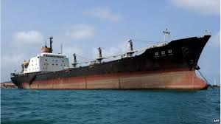
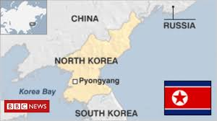
DPRK Typology – Weihai World Shipping Freight
Weihei
Ship Manager
Same address and Phone #
UK Company 1
Directorship
UK Company 2
UK Company 3
Backpacker hostel Myanmar

Slide 41
DPRK Typology – Weihai World Shipping Freight
UK companies face less skepticism and scrutiny
“veneer of respectability”
Easier for UK Companies to open bank accounts around the world
Easy to register UK Company – never have to set foot in UK

Slide 42
DPRK Typology 2 – Beyond the TFS list
Persons A and B studying in Canada
Company 1 sent electronic funds transfers to students
No apparent connection between students and company
Company 1 discovered to be WMD procurement agency
Students sponsored to study science and engineering
-> Persons not on TFS lists can be agents for DPRK

Slide 43
Iran Typology 1 – Corporate Structuring
Mr. Li controlled large network of manufacturing companies
1 company on TFS list in 2006, Mr. Li listed in 2009
Mr. Li attempted to evade sanctions by incorporating new companies as soon as the other one was listed
Between 2007 and 2013, companies received almost $7 Million through bank accounts, including via US correspondents

Slide 44
Iran Typology 1 – Corporate Structuring
MTTO Industry 2011-2014
Success Move 2011-2014
Dalian Zhongchuang 2010-2011
Sinotech 2009-2014
ABC Metallurgy 2008-09
Ansi Metallurgy 2007-08
Blue Sky 2007
Wealthy Ocean 2007
LIMMT Metallurgy and Minerals (1998-2008)

Slide 45
Iran Typology 2 – IFCs
Individual A: Iranian/EU National
Resident in EU member state, bank account in another state
Operated brokerage through front company in BVI
Front company had bank account in Dubai and in EU member state
Received funds from Dubai branch of Iranian bank
Funds transferred to Luxembourg and various member states
Iranian persons in Luxembourg sent funds to company’s EU bank account

Slide 46
Iran Typology 2 – IFCs
Iranian Bank
Dubai Branch
Dubai Bank Account
BVI Company
EU Bank Account
Luxembourg Suppliers
Lux Bank Account
Various EU Countries

Slide 47
Generic Typology - Professional Services Firm
Individual A requested his professional services firm to wire money to shell company in Asia
Shell company controlled by legal person in sanctioned country
Funds beneficiary refused to provide beneficiary information for wire transfer

Slide 48
Typologies related to legal profession
Most typologies relate to manufacturing and purchase of goods, and shipping
Most typologies involve company formation
Some typologies on real estate purchase and leasing
Some typologies on PPS and infrastructure projects
- No typologies found that involved trusts, structured finance, investment funds

Slide 49
Red Flags relevant to Legal Profession
Geographical Red Flags
Transactions involve foreign country of proliferation concern (i.e. Iran and North Korea) or country of diversion concern (e.g. China, particularly Liaoning and Jilin provinces, Hong Kong, Singapore and Malaysia), or Syria, Egypt, the United Arab Emirates and Yemen in the case of Iran.
Transaction involves financial institutions with known deficiencies in AML/CFT controls or located in weak export control and enforcement jurisdiction. For example, it is known that North Korea has used correspondent accounts held with Chinese banks to facilitate its international financial transfers.
Company Formation Red Flags
Company details (e.g. address, telephone number, directors, beneficial owners) similar to those of sanctioned company or person
Ultimate beneficial owners not identified
Obvious alterations to third party documents or the documentation appears illogical, altered, fraudulent or is absent.
Corporate structure includes shell companies.
(source: Project Alpha typologies Report 2017)

Slide 50
Red Flags relevant to Legal Profession
Client related red flags
The client or its counterparty or its address is similar to one of the parties found on publicly available lists of “denied persons”.
Client activity does not match business profile or end-user information does not match end-user profile. A client engages in a transaction that lacks business sense or strategy, or that is inconsistent with historical pattern of activity.
Clients or counterparties are linked
Client vague or inconsistent in information it provides, resistant to providing additional information when queried (* maybe not PF but other financial crime).
Transaction Red Flags
Ultimate beneficiaries not fully identified
Involvement of small trading, brokering or intermediary carrying on business inconsistent with normal business
(source: Project Alpha typologies Report 2017)

Slide 51
Resources
Financial Action Task Force: www.fatf-gafi.org
FATF Typologies Proliferation Financing Report (2008)
FATF Guidance on Counter Proliferating (2018)
Project Alpha – 60 PF Typologies https://www.kcl.ac.uk/alpha/assets/fop-13-october-2017-final.pdf
Financial Reporting Authority: www.fra.gov.ky
Office of Financial Sanctions Implementation (UK)
https://www.gov.uk/government/publications/current-list-of-designated-persons-terrorism-and-terrorist-financing
Royal United Services Institute for Defence and Security Studies: www.rusi.org
Countering Proliferation Finance: An Introductory Guide for Financial Institutions (2017)
Guide to Conducting a National Proliferation Risk Assessment (2019)
UN Panel of Expert Reports on DPRK and Iran
www.un.org/securitycouncil/sanctions/1718/panel_experts/reports
UNODC – Role of the FATF on CPF

Slide 52
Questions

